Slide 1
VA8801 SDK Handbook V3.4 Jason Syu

Slide 2
Outline
VA8801 AI Chip Introduction
VA8801 Development Preparation
VA8801 Projects and AI Toolchain Introduction
VA8801 Firmware Update and AI Model Validation Introduction

Slide 3
Outline – VA8801 AI Chip Introduction
SDK Directory Introduction
Architecture Introduction
AI Model Zoo Introduction
Starting
SDK Directory Introduction
Architecture Introduction
AI Model Zoo Introduction

Slide 4
Outline – VA8801 Development Preparation
How to Bring Up DemoKit Board
How to Install Development Environment
How to Start Development
Starting
Bring Up DemoKit Board
Install Development Environment
(VSCode+EIDE)
Starting VA8801 Development

Slide 5
Outline – VA8801 Projects and Tools Introduction
SDK TinyML Project Brief
SDK NPU Project Brief
How to Using Tengen Compiler (AI Model Compiler)
Starting
TinyML Project Brief
NPU
Project Brief
Tengen Compiler Introduction

Slide 6
Outline – VA8801 Firmware Update and AI Model Validation Introduction
How to Update VA8801 Firmware via DFU(Device Firmware Update) Tool
How to Validation AI Model(.tflite int8) on VA8801 chip via DUT(Device Under Test) tool
Starting
DFU Tool
Update VA8801 Firmware
DUT Tool
Validation TFLite INT8
Model on Chip

Slide 7
VA8801 AI Chip Introduction

Slide 8
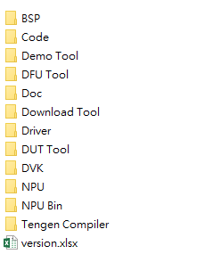
VA8801 SDK Directory Introduction – 1
Folder | Description
BSP | VA8801 BSP(Board Support Package) introduction
Code | VA8801 SDK Source code
Demo Tool | Display the result image after AI inference. Ex. Detect a human face and enclose it with a bounding box.
DFU Tool | Device Firmware Update(DFU) tool via USB update VA8801 firmware
Doc | VA8801 Video CDM_ROI User guide VA8801 Datasheet VA8801_DUT_Guide_V1.0.pdf SDK SW API comment doc VSCode for Development VA8801 IDE VA8801_SDK_Handbook_V3.3.pdf

Slide 9
VA8801 SDK Directory Introduction – 2
Folder | Description
Download Tool | Generate VA8801 Output binary file Update VA8801 Firmware via UART3
Driver | DediProg SF600Plus_Driver for VA8801 FW update, If you have an SF600 Plus device WinUSB_Driver for VA8801 USB transfer image PC_UART_Drivers for print VA8801 log message
DUT Tool | The Device Under Test (DUT) tool provides user-fed image data from a PC or Notebook, then validates the AI model
DVK | VA8801 Demo Kit Schematic
NPU Bin | VA8801_DLA_Guide_V0.4.pdf
Tengen Compiler | Use the Fitipower AI Compiler to compile the AI model into C code

Slide 10
VA8801 Architecture Introduction – 1
VA8801 AI Chip
CPU(System)
NPU(AI)
TinyML
Project
Tengen Compiler
And
NPU Project

Slide 11
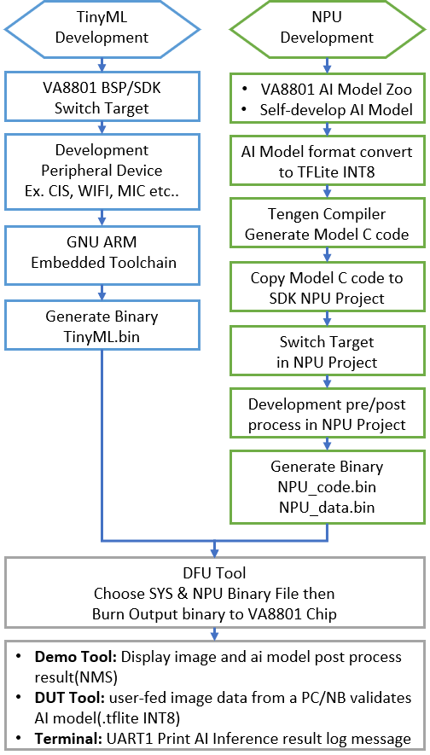
VA8801 Architecture Introduction – 2
TinyML Project
VA8801 BSP/SDK Switch Target - Dual_AV(audio+video) , Face_detection , Gesture
The above Targets have corresponding Targets in NPU Project
if the [TinyML project chooses: Gesture], the [NPU Project Target also chooses: Gesture]
NPU Project
VA8801 AI Mode Zoo
https://github.com/FITI-HCITA/VA8801_Model_Zoo
git clone https://github.com/FITI-HCITA/VA8801_Model_Zoo.git
Self-develop AI Model
Support OPs, please refer to DLA Docs SDK root path\NPU\VA8801_DLA_Guide_V0.4.pdf)
If using PyTorch to train the AI model, you need to export it in .onnx format → convert to TensorFlow → Quantize INT8(Full integer quantization) →INT8 AI model (.tflite)
If using TensorFlow to train the AI model → Quantize INT8(Full integer quantization) → INT8 AI model (.tflite)
The current Tengen Compiler supports only TFLite INT8
Generate AI Model C Code in your specified INT8 AI model (.tflite) path
Copy Model C code to SDK NPU Project
Reference SDK root path\VA8801_BSPSDK_v4.000.001\Tengen Compiler\Tengen Compiler User Guide v1.4.pdf
NPU Switch Target
If the NPU project chooses Gesture, the TinyML Project Target also chooses Gesture
if self-develop AI Model , you can reference Gesture Target then modify meet your app (ref Self-develop AI Model – How to Modify SDK Project)
Development pre/post process
Self-define development pre/post process in SDK NPU Project main_and_config folder
Reference SDK root path\VA8801_BSPSDK_v4.000.001\Doc\VSCode\VSCode_Toolchain_Build System_user guide_v2.0.pdf

Slide 12
VA8801 Architecture Introduction – 3
DFU(Device Firmware Update) Tool
Reference SDK root path\VA8801_BSPSDK_v4.000.001\DFU Tool\ FITI_VA8801_DFU_ToolKit_v1.0.0.pdf
Demo Tool
Reference SDK root path\VA8801_BSPSDK_v4.000.001\Demo Tool\ VA8801_Demo_Tool_UserGuide_V0.1_20240305.pdf
Others tool - DUT(Device Under Test) tool
The Device Under Test (DUT) tool provides user-fed image data from a PC or notebook, then validates the AI model(.tflite INT8)
Reference SDK root path\VA8801_BSPSDK_v4.000.001\DUT Tool\ VA8801_DUT_Guide_V1.0.pdf
Notes. The AI model and image data share DDR memory. The memory layout can be referenced as follows:
DDR_16M Memory Layout
DDR use example:
0x80000000
AI Model
C Code
Usage Space
0x80000000
AI Model
C Code
Usage Space
(15.7MB)
0x80FB4FFC
AI Model
Input Image data
Usage Space
0x80FB5000
Image data
(320x320x3)
(size:0.3M)
0x81000000
0x81000000

Slide 13
VA8801 AI Model Zoo Introduction
We provide a series of pre-trained models for different application scenarios for you to use, with Fitipower VA8801 SDK, you can test or inference on these models and easily deploy them to VA8801 device
VA8801 Model Zoo focuses on providing models trained on VA8801 optimized neural networks, which are tailored to real-world application scenarios and enable faster and more accurate inference on VA8801 device. We will provide more models later
VA8801 AI Model Zoo github link
https://github.com/FITI-HCITA/VA8801_Model_Zoo

Slide 14
VA8801 Development Preparation

Slide 15
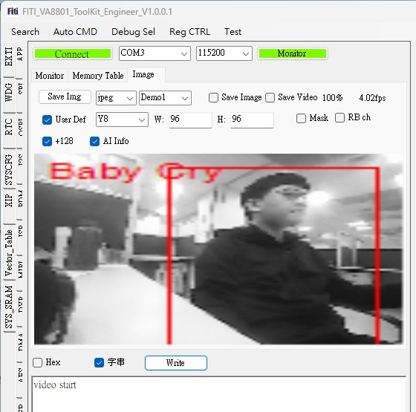
How to Bring Up DemoKit Board – 1
The default firmware for the VA8801 DemoKit is Dual_A_V
Audio – abnormal sound recognize(such as baby crying)
Video – Human detection
Power supply
Micro USB connect to PC/NB
Adapter - output 5V
Use the Demo Tool to display images and human detection results
Demo Tool :

Slide 16
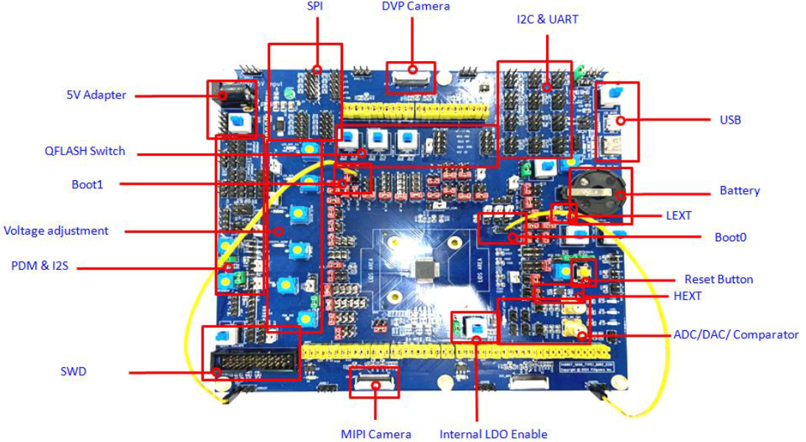
How to Bring Up DemoKit Board – 2
*push up – power on
Button:
Power supply: Micro USB connect to PC/NB
VA8801 Demo kit board

Slide 17
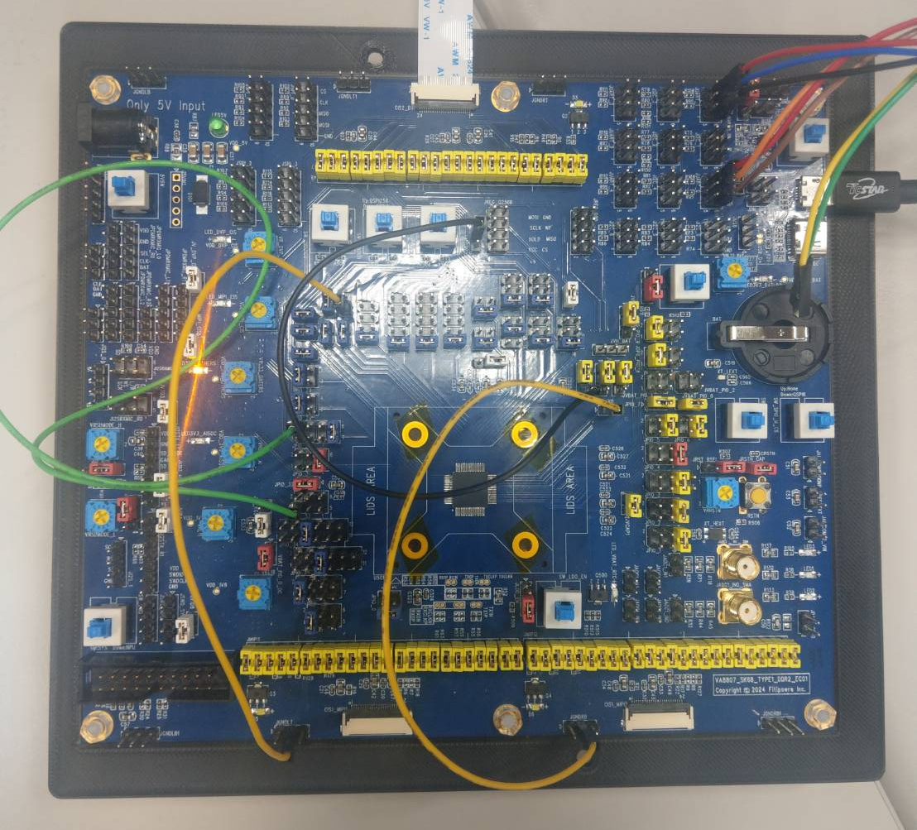
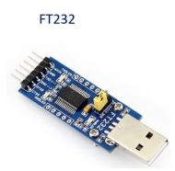
How to Bring Up DemoKit Board – 3
Pin from top to bottom:
P1.UART_RX
P3.UART_TX
P5.UART_GND
UART1(NPU log)
UART0(System)
FT232 connect to PC/NB
FT232_RX connect to UART_TX
FT232_TX connect to UART_RX
FT232_GND connect to UART_GND
Micro USB connect to PC/NB
Push button to power on
VA8801 Demo kit board

Slide 18
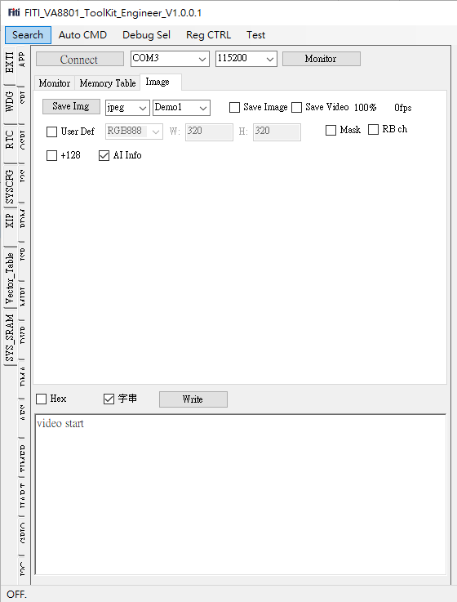
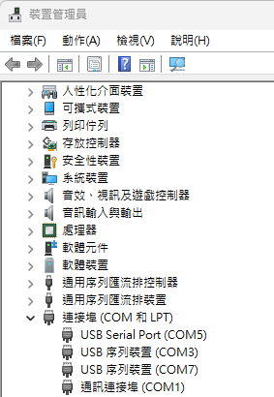
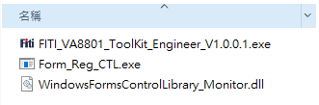
How to Bring Up DemoKit Board – 4
1.
2.
Demo Tool
4.
3.
5.
Step 1. Click on "Search"
Step 2. Choose the COM port; you can check in Device Manager under "Ports (COM & LPT)" to find the COM port associated with a USB serial device
Step 3. Switch to the "Image" page
2.
*The first time you use it, after VA8801 is powered on, you need to install the WinUSB Driver.
(SDK root path\VA8801_BSPSDK_v4.000.001\Driver\WinUSB_Driver.7z)
6.

Slide 19
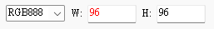
How to Bring Up DemoKit Board – 5
1.
2.
Demo Tool
4.
3.
5.
Step 3. Switch to the "Image" page
Step 4. Click "Connect"
Step 5.
Tick User Def
Face Detection, Gesture - RGB888 W:320 H:320
A+V - Y8 W:96 H:96
Push enter after input W and H (red text will turn black)
Face Detection, Gesture - Tick RB ch
Tick +128
Tick AI info - Enable AI info (bounding box)
Step 6. Click "Write"
6.

Slide 20
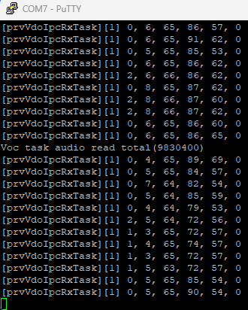
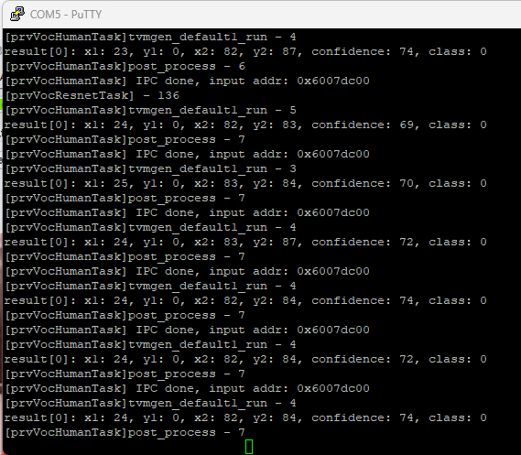
How to Bring Up DemoKit Board – 6
Description
When abnormal sound is detected, the output will be the display abnormal sound (such as baby crying)
Using NB or smartphone ..etc play folder [Abnormal Sound file\Baby_cry.wav]
Human detection(Gray) + Abnormal sound recognize result
UART0 System log
UART1 NPU log

Slide 21
How to Bring Up DemoKit Board – 7
1.
2.
Demo Tool
4.
3.
5.
Step 3. Switch to the "Image" page
Step 4. Click "Connect"
Step 5.
Tick User Def
Face Detection, Gesture - RGB888 W:320 H:320
A+V_RGB – RGB888 W:320 H:320
Push enter after input W and H (red text will turn black)
Face Detection, Gesture - Tick RB ch
Tick +128
Tick AI info - Enable AI info (bounding box)
Step 6. Click "Write"
6.

Slide 22
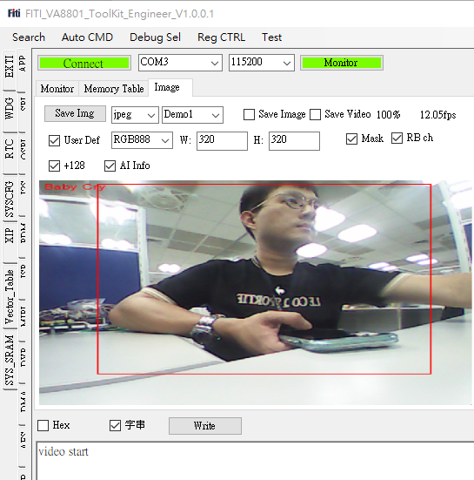
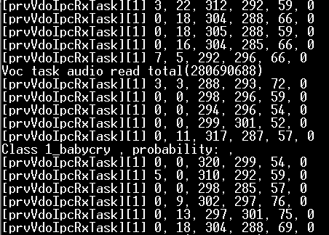
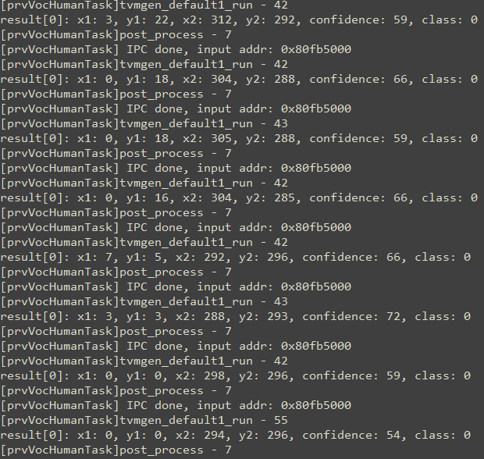
How to Bring Up DemoKit Board – 8
Description
When abnormal sound is detected, the output will be the display abnormal sound (such as baby crying)
Using NB or smartphone ..etc play folder [Abnormal Sound file\Baby_cry.wav]
UART0 System log
UART1 NPU log
Human detection(RGB) + Abnormal sound recognize result

Slide 23
How to Install Development Environment
Install Visual Studio Code(VSCode)
https://code.visualstudio.com/download
Install Embedded IDE(EIDE) plug in VSCode
https://marketplace.visualstudio.com/items?itemName=CL.eide
Install .NET6 X64 Runtime package
After install EIDE done, The plug-in will auto download and install eide-binaries and .NET6 X64 Runtime package
Install GNU Arm Embedded Toolchain in VSCode
Detail reference :
SDK root path\VA8801_BSPSDK_v4.000.001_release\Doc\VSCode\VSCode_Toolchain_Build System_user guide_v2.0.pdf

Slide 24
How to Start Development
Bring up VA8801 DVK
Let’s
Start
Install WinUSB driver
Install UART driver
DFU Tool
Choose TinyML.bin +
NPU_code.bin + NPU_data.bin
then Burn to VA8801
Install VSCode Development Kit
Demo Tool: Display image and ai model post process result(NMS)
DUT Tool: user-fed image data from a PC/NB validates AI model(.tflite INT8)
Terminal: UART1 Print AI Inference result log message
git clone VA8801
Model Zoo
Tengen Compiler
Generate Model C code
Build TinyML Project
Build NPU Project

Slide 25
VA8801 Projects and AI Tool Introduction

Slide 26
VA8801 Projects and AI Tool Introduction
The VA8801 SDK project is divided into CPU(System) and NPU(AI) projects, each with its corresponding Target
CPU(System)
NPU(AI)
CPU(System)
NPU(AI)
TinyML Project
Choose Target
Dual_A_V
NPU Project
Choose Target
Dual_AV
TinyML Project
Choose Target
Gesture
NPU Project
Choose Target
Gesture
CPU(System)
NPU(AI)
TinyML Project
Choose Target
Face_Detection
NPU Project
Choose Target
Face_Detection

Slide 27
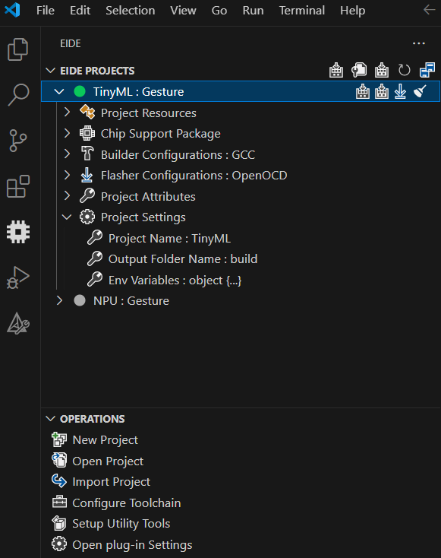







VA8801 TinyML Project Brief
Project Resources
Display project source code folder, builder output files
Chip Support Package
Ignore
Builder Configuration
Setting CPU Type, Linker Script(.ld), Complier/Linker configuration etc..
Flasher Configuration
Setting Debug mode configuration
Project Attributes
Setting Project Include header file paths, Preprocessor Defines, Library Search Directories etc..
Project Setting
Setting Project Name, Output Folder Name, Environment Variables
EIDE Project
Build
Clean
Program Flash
Rebuild
Project Status
Project Activated
Project Deactivated

Slide 28
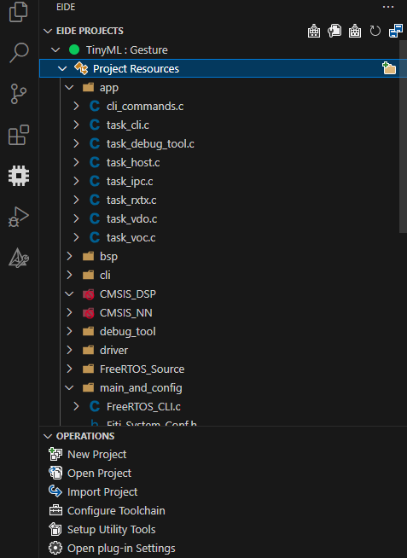
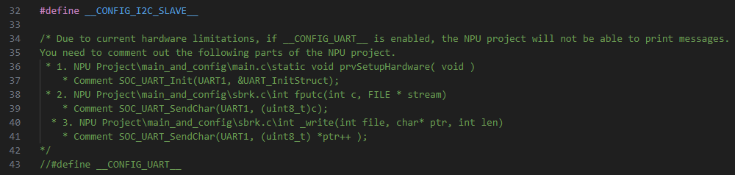
VA8801 TinyML Project Brief – task_host.c 1
You can develop your application in task_host.c
For example, AI inference results can be transmitted to applications, such as the main board SOC or MCU, through peripheral interfaces like I2C or UART
Current support I2C Slave(Default) & UART Interface
I2C Salve enable : #define __CONFIG_I2C_SLAVE__
UART enable :#define __CONFIG_UART__
Sample code reference chapter SDK Peripheral Example Code

Slide 29
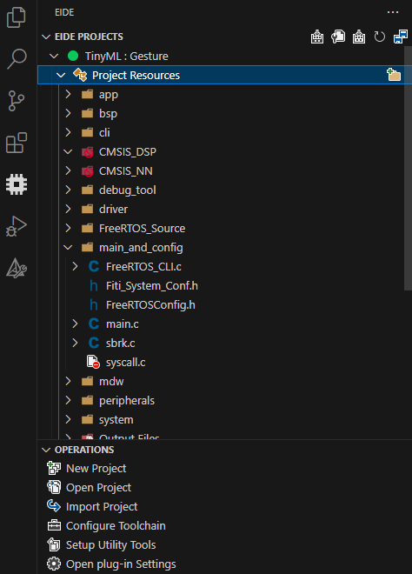
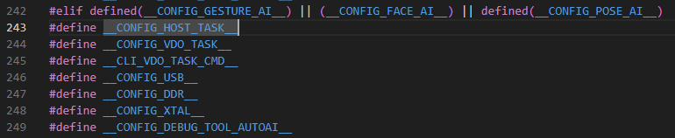
VA8801 TinyML Project Brief – task_host.c 2
How do Enable Task host
#define __CONFIG_HOST_TASK__

Slide 30
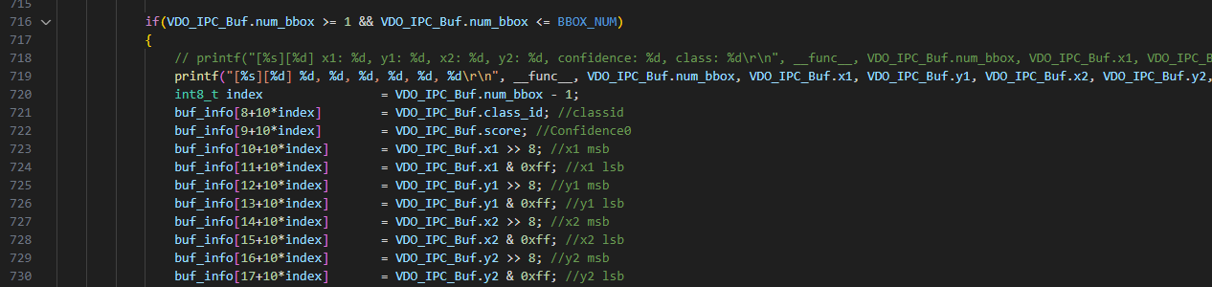
VA8801 TinyML Project Brief – task_vdo.c
The results of AI inference will be sent back to the TinyML project via the IPC interface
static void prvVdoIpcRxTask( void *pvParameters )
buf_info [0] to buf_info[7] : transmit header
buf_info [8] to buf_info[17] : AI inference result 1
buf_info [18] to buf_info[27] : AI inference result 2
And so on and so forth…

Slide 31
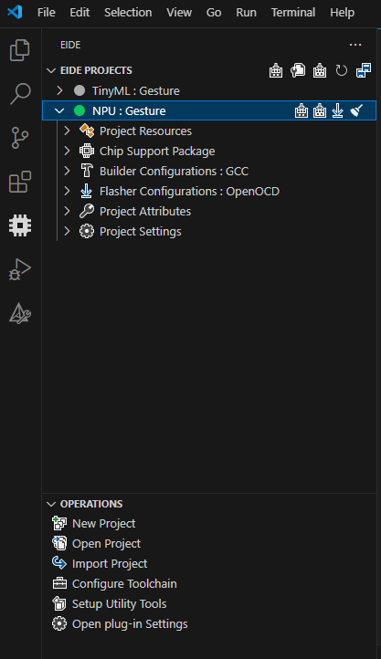
VA8801 NPU Project Brief
Project Resources
Display project source code folder, builder output files
Tengen Compiler output file(AI Model C code)
Chip Support Package
Ignore
Builder Configuration
Setting CPU Type, Linker Script(.ld), Complier/Linker configuration etc..
Flasher Configuration
Setting Debug mode configuration
Project Attributes
Setting Project Include header file paths, Preprocessor Defines, Library Search Directories etc..
Project Setting
Setting Project Name, Output Folder Name, Environment Variables
EIDE Project
Build
Clean
Program Flash
Project Status
Rebuild
Project Activated
Project Deactivated

Slide 32
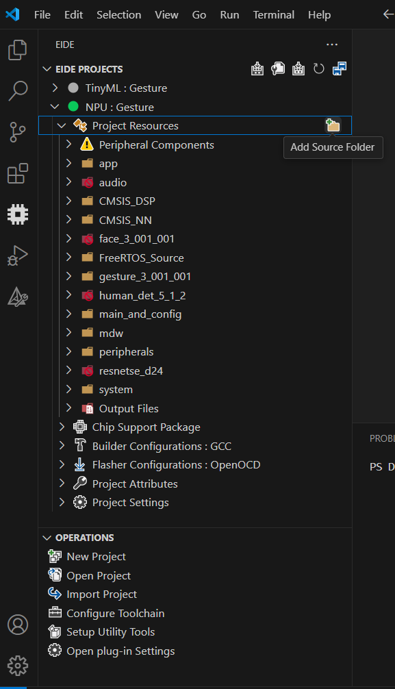
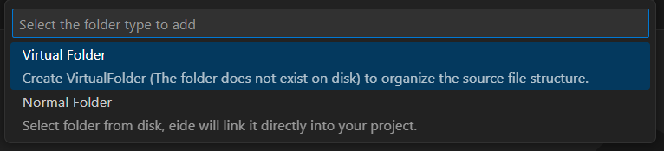
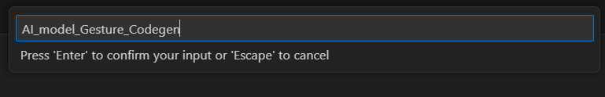
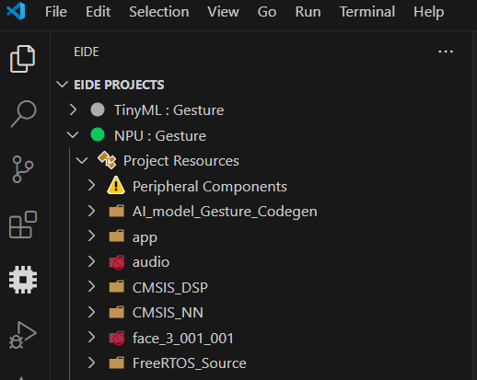
How to Add Tengen Compiler output C code(AI Model) in NPU Project – 1

Slide 33
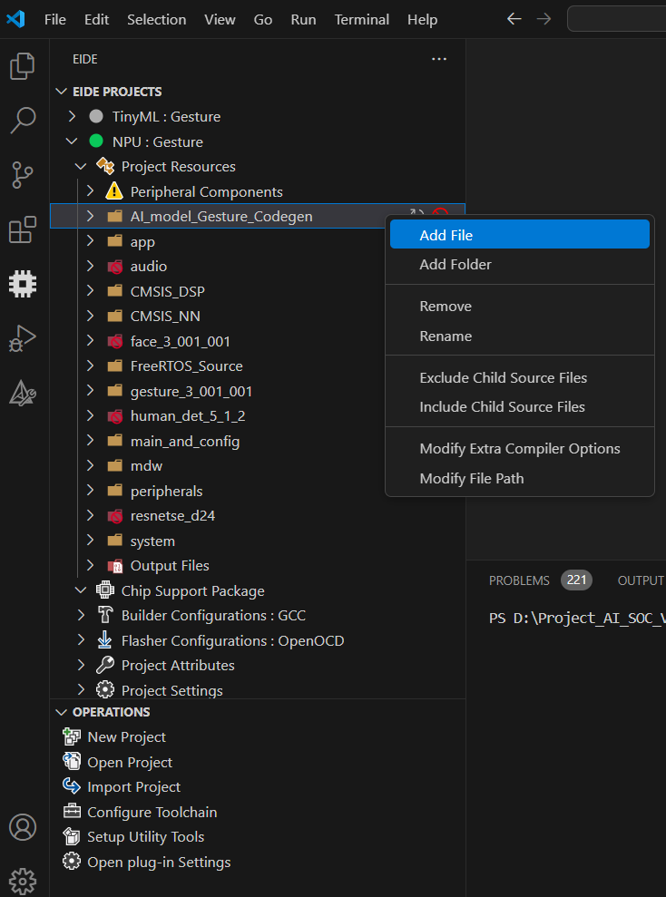
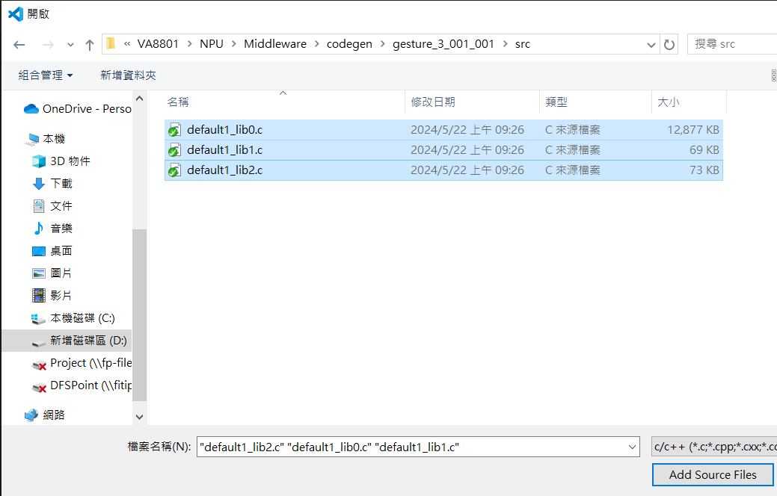
How to Add Tengen Compiler output C code(AI Model) in NPU Project – 2

Slide 34
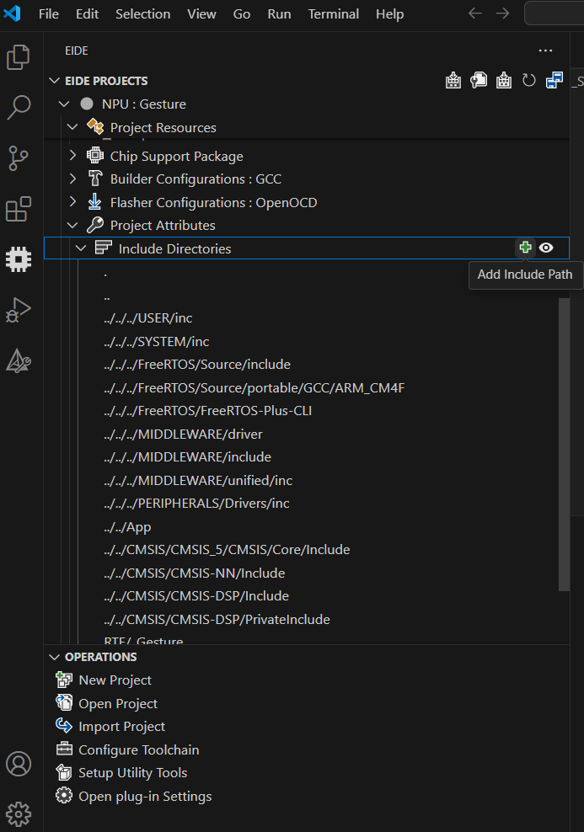
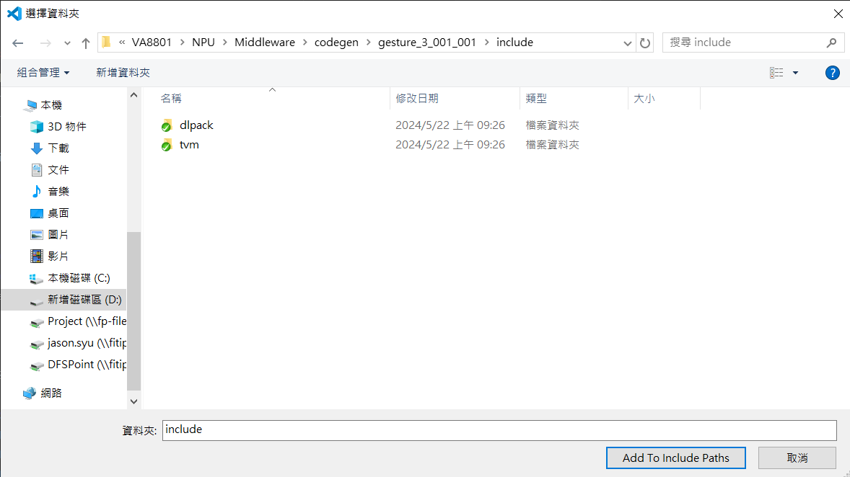
How to Add Tengen Compiler output C code(AI Model) in NPU Project – 3

Slide 35
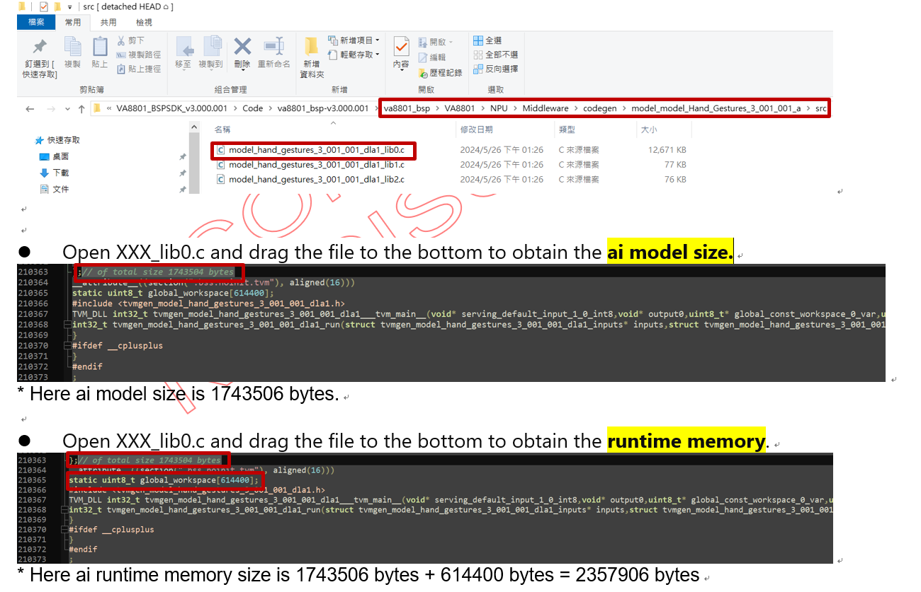
How to Obtain AI Model Size
referenced in the "XXX_lib0.c" file in the src folder of the AI Model C code generated by the Tengen compiler.

Slide 36
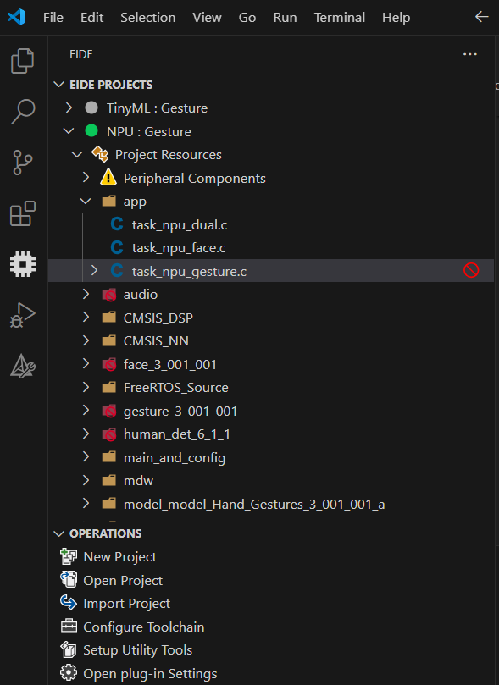
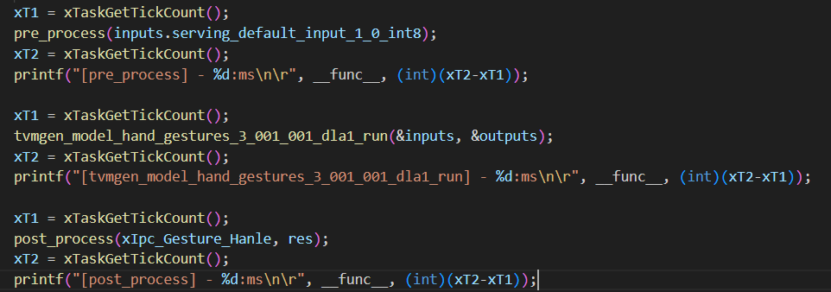
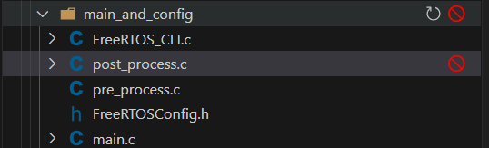
How to Obtain Pre/Post process and inference time in NPU Project
static void prvGestureTask( void *pvParameters )
Here you can self-define pre/post process develop

Slide 37
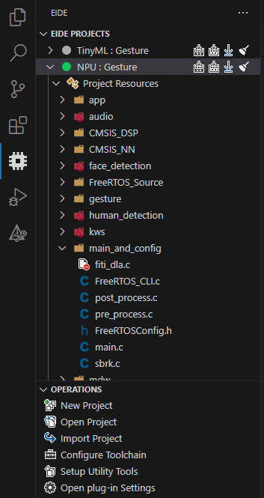
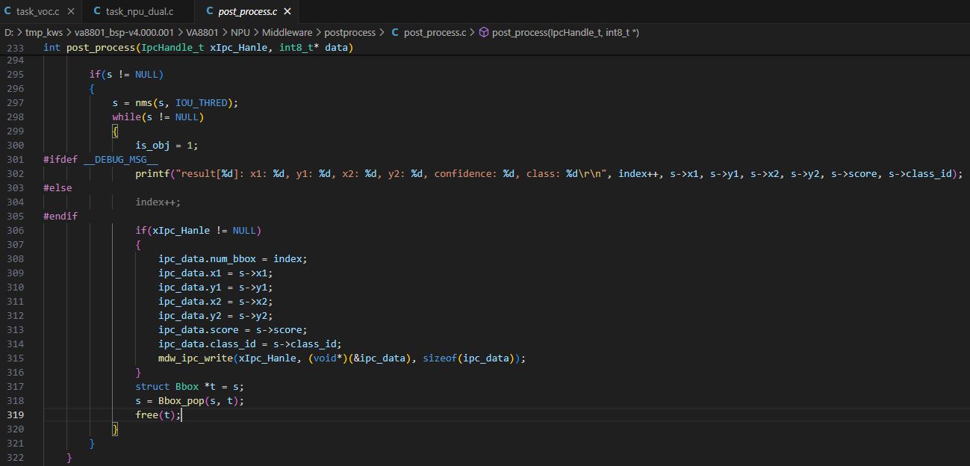
VA8801 NPU Project Brief - post_process.c
Transfer the post-processed (NMS) results of AI inference to the TinyML project on the left via the IPC interface

Slide 38
How to Using Tengen Compiler – 1
Prerequisites
Window OS and install Docker Desktop and WSL2 on Windows
At least free memory space 3.5GB
Tengen Compiler image: tengen_v1.001.008.tar
Purpose
Compile the AI model into C code, then use the VA8801 SDK NPU project to compile the AI model C code into binary files, and deploy them to the VA8801 chip
Current version Limitations
Support TensorFlow Lite and quantized to int8 model only
Support OPs, please refer to DLA Docs SDK root path\ VA8801_BSPSDK_v4.000.001\NPU\ VA8801_DLA_Guide_V0.4.pdf)
AI Model Size Limitations
The AI model shares DDR memory with image data, and the DDR memory size is 16MB.
For example, if the resolution of the image data for the model is 320x320x3(about 0.3MB), the size of the AI model should be approximately less than 15.7MB
Detail reference SDK root path\VA8801_BSPSDK_v4.000.001\Tengen Compiler\Tengen Compiler User Guide v1.0.3.pdf

Slide 39
How to Using Tengen Compiler – 2
Open docker desktop ap after docker install done
Open terminal(ex. PowerShell) then Point the path to the directory location of Tengen
Docker command to load image from tar file(file name reference SDK root path\ VA8801_BSPSDK_v4.000.001\ Tengen Compiler\tengen_vx.x.x.tar )
EX: docker load --input tengen_v1.1.0.tar
Docker command to check images
EX: docker image ls

Slide 40
How to Using Tengen Compiler – 3
You can also see the image at docker desktop

Slide 41
How to Using Tengen Compiler – 4
Docker command to run Tengen service:
docker run -v $Folder:/volume tengen:v1.001.008 ./tengen --dla_version $DLA_VERSION --compile_mode $MODE --model_path volume/$FILE –name default1 --output_folder /volume
Parameters:
-$FOLDER: The folder model located:
-$FILE: The model file name
-$DLA_VERSION: Support: 3.7.4, 3.9.2, latest
-$MODE: 0: Pure C Codegen, 1: Dual DLA (Suggested options), 2: Single DLA
Then, you can find output folder at your $FOLDER, the name will be model_$FILE
Example Docker command :
docker run -v D:\VA8801_Documnet_SDK\tmp_sdk3.0\VA8801_BSPSDK_v4.000.001\Model_zoo\VA8801_Model_Zoo\ObjectDetection\Hand_Gestures:/volume tengen:v1.001.008 ./tengen --dla_version 3.7.4 --compile_mode 1 --model_path volume/Hand_Gestures_3_001_001.tflite --output_folder /volume
Green : Enter your ai model local path
Yellow : Enter Tengen version. The Tengen version, you can navigate to the SDK root path: \VA8801_BSPSDK_v4.000.001\Tengen Compiler\tanger_vx.x.x
Purple : Enter your Model name

Slide 42
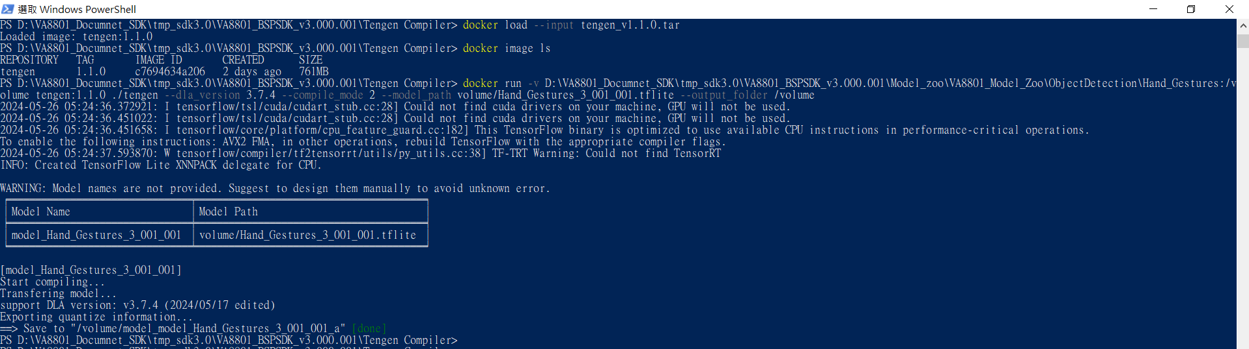
How to Using Tengen Compiler – 5
Model codegen done

Slide 43
VA8801 Firmware Update and AI Model Validation Introduction

Slide 44
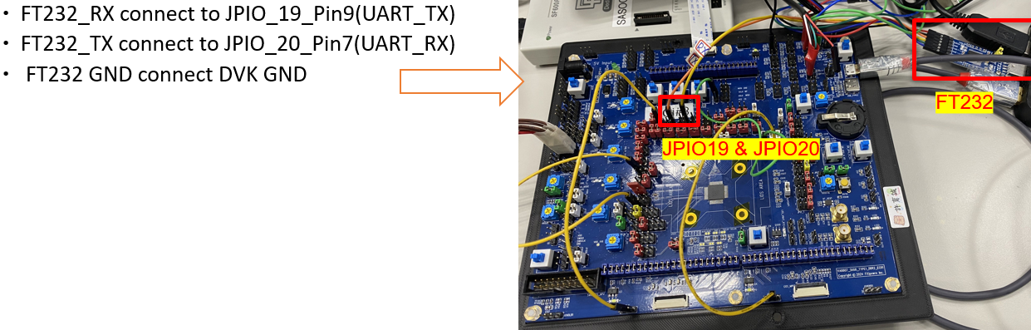
How to Update VA8801 Firmware via DFU(Device Firmware Update) Tool – 1
For the first use, you need to update the VA8801 Second Bootloader firmware
Prepare a UART to USB adapter (e.g., FT232) for the hardware
VA8801 DVK HW UART3 Setup and FT232 connect to PC/NB

Slide 45
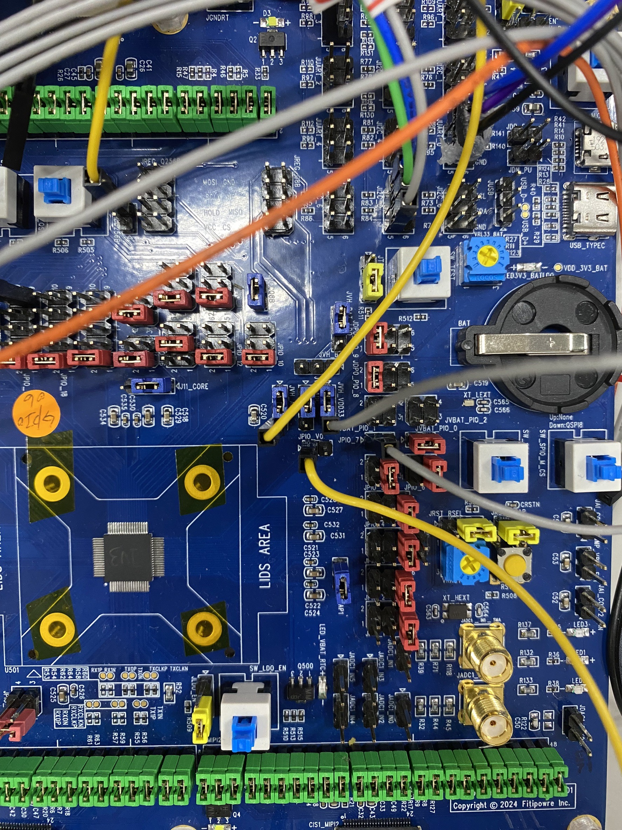
How to Update VA8801 Firmware via DFU(Device Firmware Update) Tool – 2
For the first use, you need to update the VA8801 Second Bootloader firmware
Prepare a UART to USB adapter (e.g., FT232) for the hardware
Connect the DuPont line from VA8801 DVK HW JPIO_7_Pin1 (near the arrow) to JVH_VDD33 to pull it high
JVH_VDD33
JPIO_7_Pin1
*If there is a jumper, please remove it.

Slide 46
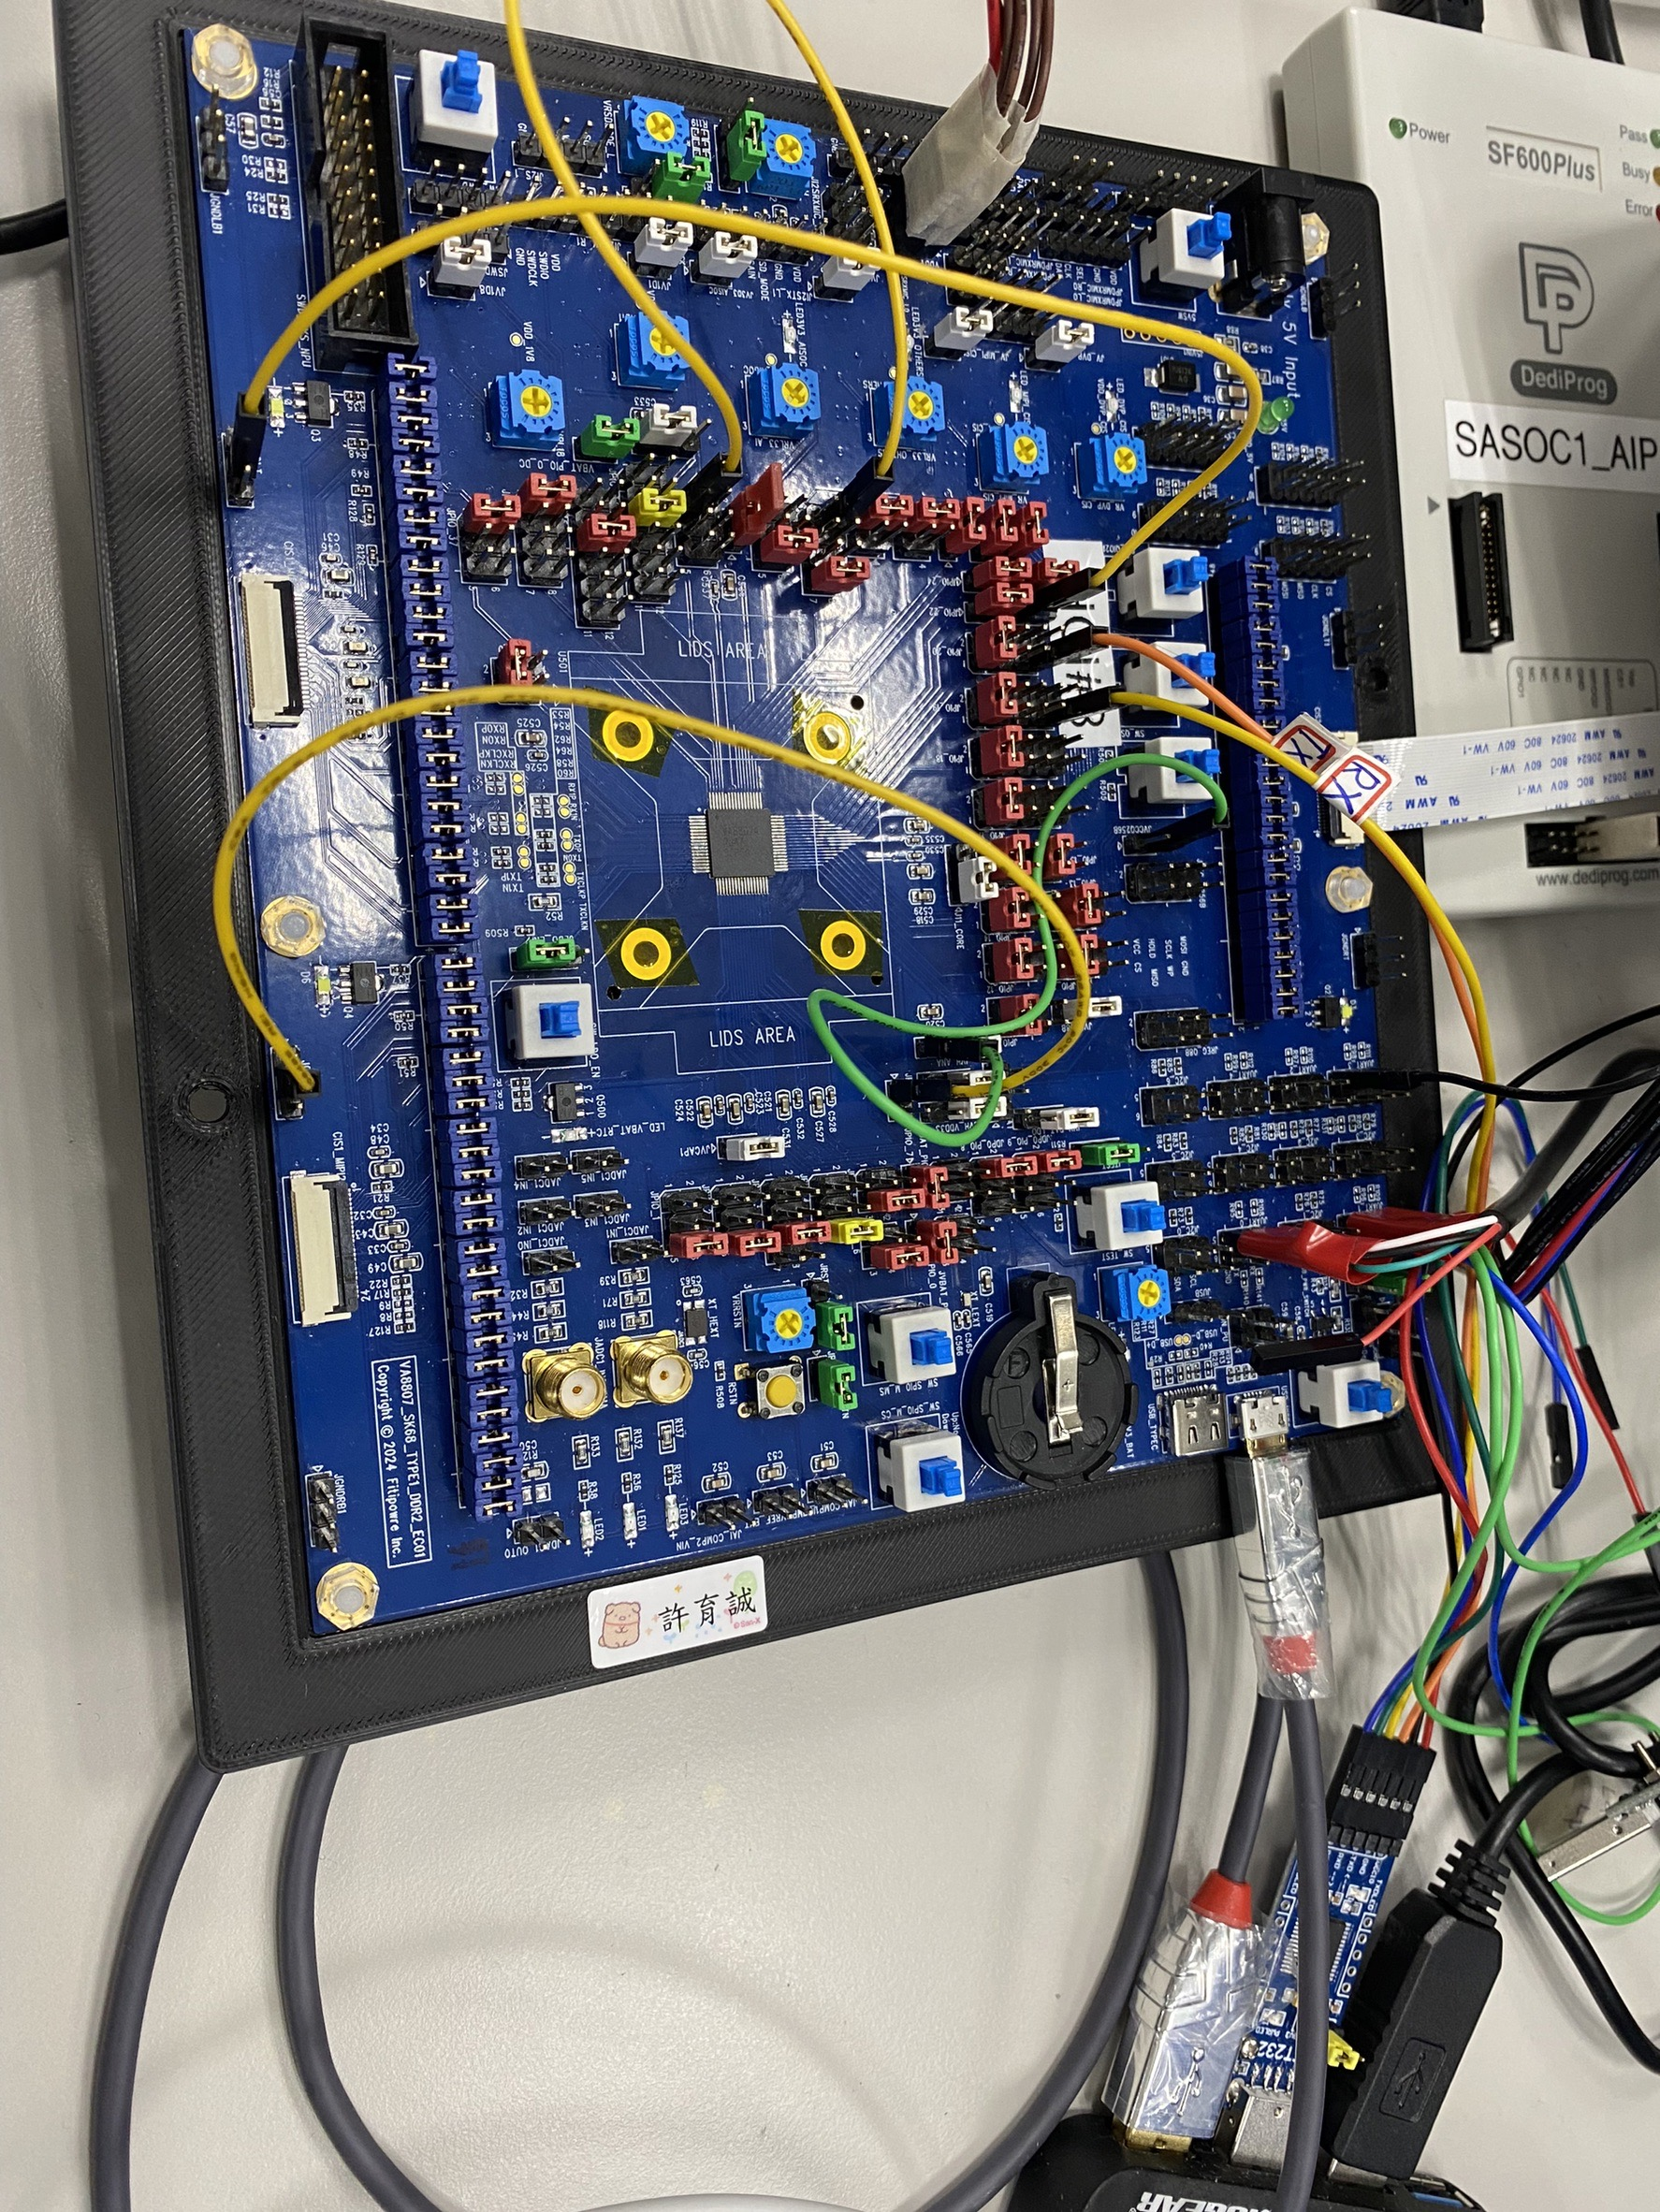
How to Update VA8801 Firmware via DFU(Device Firmware Update) Tool – 3
For the first use, you need to update the VA8801 Second Bootloader firmware
Prepare a UART to USB adapter (e.g., FT232) for the hardware
VA8801 Flash Button setup – Middle Button Push Down , Right/Left Push Up
Up Down Up
Reset button
GND

Slide 47
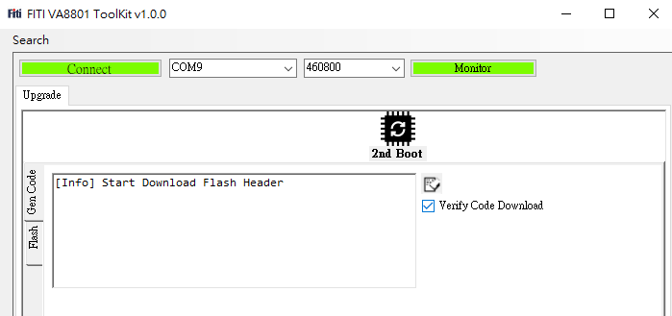
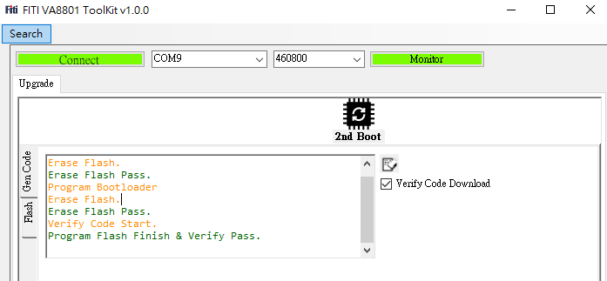
How to Update VA8801 Firmware via DFU(Device Firmware Update) Tool – 4
Use the DUT Tool to update the second bootloader firmware via UART3
Search UART3 the COM port; you can check in Device Manager under "Ports (COM & LPT)" to find the COM port
Baud rate 460800
Click Connect
Click VA8801 DVK Reset Button
Display [Info] Start Download Flash
Header log message
HW setup: VA8801 DVK Flash Button setup –
All button Push Up
Click 2nd Boot diagram upgrade the VA8801
Second Bootloader firmware
VA8801 Second Bootloader Update done
HW setup: Click VA8801 Reset Button
Second Bootloader update done.

Slide 48
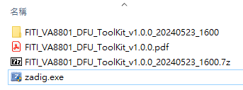
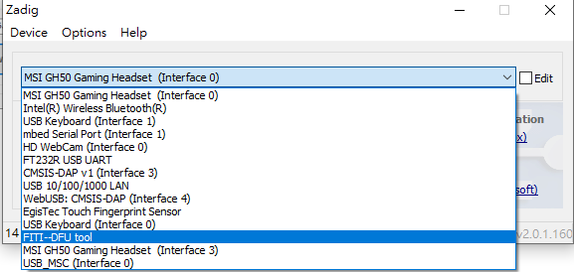
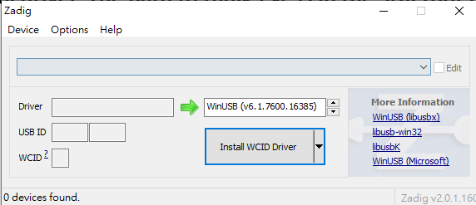
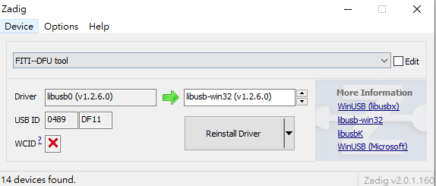
How to Update VA8801 Firmware via DFU(Device Firmware Update) Tool – 5
Use zadig.exe to install the FITI DFU Tool driver. The path to zadig.exe is in the SDK root path\VA8801_BSPSDK_v4.000.001\DFU Tool
Select Options → List All Devices
Select libusb-win32(v1.2.6.0)
Click Install Driver

Slide 49
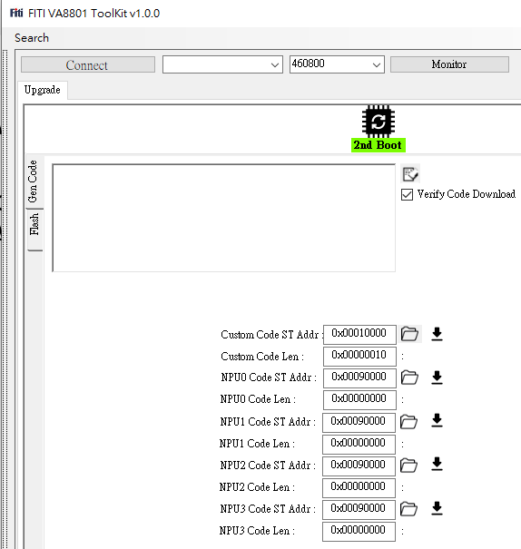
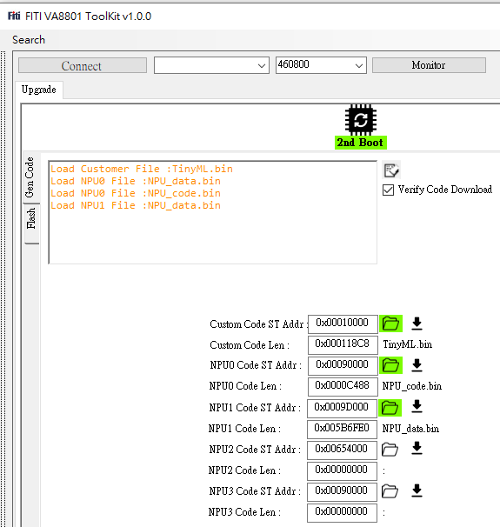
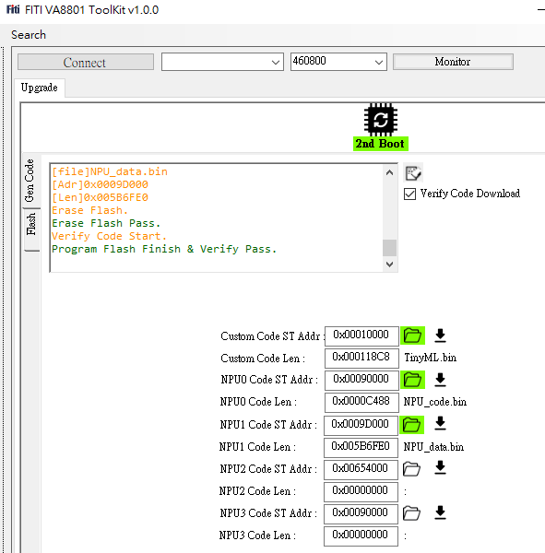
How to Update VA8801 Firmware via DFU(Device Firmware Update) Tool – 6
Now, close and reopen the DFU Tool, then you can use the DUT Tool to update the VA88001 firmware
The wiring of VA8801 DVK UART3 can be removed
If the second boot is successful, the DFU Tool will light up green
Update the firmware sequentially following the black arrow symbols
Click on the folder icon and select the binary file
Custom Code ST Addr: TinyML.bin
NPU0 Code ST Addr: NPU_code.bin
NPU1 Code ST Addr: NPU_data.bin

Slide 50
How to Update VA8801 Firmware via DFU(Device Firmware Update) Tool – 7
When VA8801 DVK FW update done, VA8801 DVK HW JPIO_7_Pin1 (near the arrow) to GND
System run After Click VA8801 DVK Reset button
You can check if the system is working properly through the terminal(ex. Tera Term) log
Detail operation reference VA8801_DUF_Tool_User_Guide.mp4
Detail Reference SDK root path\VA8801_BSPSDK_v4.000.001\DFU Tool\FITI_VA8801_DFU_ToolKit_v1.0.0.pdf
Note1. The second bootloader only needs to be updated once
Note2. If you need to update the VA8801 firmware again, you should pull JPIO_7_Pin1 high. After updating the firmware done, pull it low

Slide 51
How to Validation AI Model on VA8801 chip via DUT(Device Under Test) Tool – 1
TFLite INT8(.tflite) Model Validation
DUT Tool
Fed-image
AI Inference
on VA8801 chip
Generate
AI Inference
Results(NMS)
Test
Dataset
Compare Model
post process
Results(NMS)
PC/NB
AI Inference Simulation results
Generate
AI Inference
Results(NMS)
Detail Reference SDK root path\VA8801_BSPSDK_v4.000.001\DUT Tool\VA8801_DUT_Guide_V1.0.pdf
New DUT Tool & User guide Come soon..

Slide 52
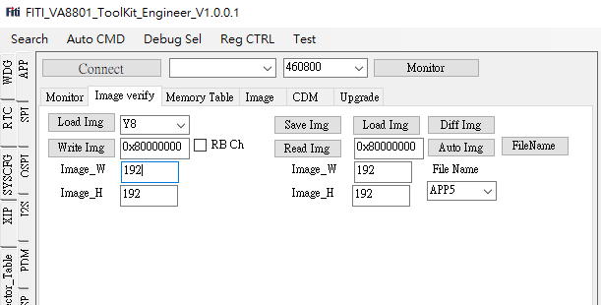
How to Validation AI Model on VA8801 chip via DUT(Device Under Test) Tool – 2
Switch 「Image verify」 page
Choose input image format
Enter DDR_320_320_3_ADDR , in VA8801\PERIPHERALS\BSP\Components\inc\ fiti_camera_cfg.h
Enter input image height, width
Choose 「 APP4 」
Choose input image in DUT Tool root path, file name fixed 1.bmp or 1.jpg
Click Auto Img
1.
2.
3.
7.
6.
4.
5.
DUT Tool
Detail Reference SDK root path\VA8801_BSPSDK_v4.000.001\DUT Tool\VA8801_DUT_Guide_V1.0.pdf

Slide 53
Appendix

Slide 54
Self-develop AI Model(Video)

Slide 55


Self-develop AI Model (Video)– How to Modify SDK Project 1
If you are developing your own AI model in TinyML and NPU projects, it is recommended to choose Gesture as the target for code-based modifications. The areas that need to be modified are as follows
TinyML Project
Modify DDR_320_320_3_ADDR address in va8801_bsp\VA8801\PERIPHERALS\BSP\Components\inc\fiti_camera_cfg.h
For example: AI Model input image : 320x320x3, DDR_320_320_3_ADDR = 0x81000000 – 0x4B000 = 0x80FB5000
DDR_320_320_3_ADDR need setting 0x88FB5000
Modify the input image resolution according to the AI model in in
va8801_bsp\VA8801\PERIPHERALS\BSP\Components\inc\fiti_camera_cfg.h
CPU(System)
NPU(AI)
TinyML Project
Choose Target
Gesture
NPU Project
Choose Target
Gesture
DDR_16M Memory Layout
0x80000000
AI Model
C Code
Usage Space
Note1. GC0308 Camera input resolution, do not modify
AI Model
Input Image data
Usage Space
Note2. RGB : #define ISP1_CH (uint16_t)3
Gray : #define ISP1_CH (uint16_t)1
0x81000000

Slide 56

Self-develop AI Model(Video) – How to Modify SDK Project 2
If you are developing your own AI model in TinyML and NPU projects, it is recommended to choose Gesture as the target for code-based modifications. The areas that need to be modified are as follows
TinyML Project
If the input image is a grayscale image, you need to change the ISP_GRAY_OUTPUT_EN setting in
va8801_bsp\VA8801\PERIPHERALS\BSP\Components\inc\fiti_camera_cfg.h
CPU(System)
NPU(AI)
TinyML Project
Choose Target
Gesture
NPU Project
Choose Target
Gesture
Note. RGB : #define ISP_GRAY_OUTPUT_EN 0
Gray : #define ISP_GRAY_OUTPUT_EN 1
DDR_16M Memory Layout
0x80000000
AI Model
C Code
Usage Space
AI Model
Input Image data
Usage Space
0x81000000

Slide 57
Self-develop AI Model(Video) – How to Modify SDK Project 3
If you are developing your own AI model in TinyML and NPU projects, it is recommended to choose Gesture as the target for code-based modifications. The areas that need to be modified are as follows
NPU Project
Modify the following item in va8801_bsp\VA8801\NPU\App\src\task_nup_gesture.c
Model head file name
Model API function name
Model struct name
va8801_bsp\VA8801\NPU\Middleware\postprocess\post_pocess.c
Self-define and development post-processing
va8801_bsp\VA8801\NPU\Middleware\preprocess\pre_process.c
Self-define and development pre-processing
Modify the image input resolution in NPU\Project\NPU\dla.h, which will be referenced in the post_process.c

Slide 58




Self-develop AI Model(Video) – How to Modify SDK Project 4
4.
5.
1.
6.
7.
8.
2.
3.
Modify the name in the red box .
referenced in the "tvmgen_model_xxx.h" file in the include folder of the AI Model C code generated by the Tengen compiler.

Slide 59


Self-develop AI Model(Video) – How to Modify SDK Project 5
1.
2.
3.
4.
7.
8.
5.
6.
The naming of 1 to 8 will be based on the AI Model

Slide 60

Self-develop AI Model(Video) – How to Modify SDK Project 6
va8801_bsp\VA8801\NPU\Project\NPU\dla.h
Modify this section of the code according to the AI model

Slide 61
Self-develop AI Model(Audio)

Slide 62


Self-develop AI Model(Audio) – How to Modify SDK Project 1
If you are developing your own AI model in TinyML and NPU projects, it is recommended to choose Dual_A_V as the target for code-based modifications. The areas that need to be modified are as follows
TinyML Project
Modify the following item in va8801_bsp\VA8801\APP\src\task_voc.c
AI Audio model quant value in static void prvVocAbnormalSoundTask(void *pvParameters)
referenced in the "tvmgen_xxx.h" file in the include folder of the AI Model C code generated by the Tengen compiler.

Slide 63
Self-develop AI Model(Audio) – How to Modify SDK Project 2
If you are developing your own AI model in TinyML and NPU projects, it is recommended to choose Dual_A_V as the target for code-based modifications. The areas that need to be modified are as follow
NPU Project
Modify the following item in va8801_bsp\VA8801\NPU\App\src\task_npu_dual.c
Model head file name
Model API function name
Model struct name

Slide 64





Self-develop AI Model(Audio) – How to Modify SDK Project 3
4.
5.
1.
6.
7.
8.
9.
10.
11.
Modify the name in the red box .
referenced in the "tvmgen_xxx.h" file in the include folder of the AI Model C code generated by the Tengen compiler.
2.
3.
64

Slide 65


Self-develop AI Model(Audio) – How to Modify SDK Project 4
2.&10.
3.
4.
8.
6.
9.
5.
7.
11.
The naming of 1 to 11 will be based on the AI Model

Slide 66
SDK Peripheral Example Code

Slide 67



TinyML Project – UART Example – HW Setup
Due to shared pin limitations, only UART1 is available on the VA8801 DemoKit for communication with the SOC or MCU
JUART_1 Pin from top to bottom:
Pin1 – UART1_RX Connect to SOC or MCU UART_TX
Pin3 – UART1_TX Connect to SOC or MCU UART_RX
Pin5 – GND Connect to SOC or MCU GND
Note. Since the NPU project uses UART1 to print messages, if you want to use UART1 to communicate with SOC or MCU, you need to comment out the following code in the NPU project.
VSCode open SDK project , then Active NPU Project
NPU Project\main_and_config\main.c\static void prvSetupHardware( void )
NPU Project\main_and_config\sbrk.c
int fputc(int c, FILE * stream) int _write(int file, char* ptr, int len)
GND
VA8801 Demo kit board

Slide 68
TinyML Project – UART Example – SW API
API List
UartHandle_t mdw_uart_open(UartNode_t eNode, unsigned long ulWantedBaud);
int32_t mdw_uart_write(UartHandle_t xUartHandle, uint8_t *pBuffer, size_t xBytes, TickType_t xBlockTime);
int32_t mdw_uart_read(UartHandle_t xUartHandle, uint8_t *pBuffer, size_t xBytes, TickType_t xBlockTime);
int32_t mdw_uart_close(UartHandle_t xUartHandle);
Sample code reference in va8801_bsp\VA8801\APP\task_host.c
UART Open Example
UartHandle_t uartHandle;
uartHandle = mdw_uart_open(eUART1, 115200);
UART Write Example
uint32_t ret;
const char *testVideoData = "object detection!\n";
size_t testVideoDataLength = strlen(testVideoData);
mdw_uart_write(uartHandle, (uint8_t *)testVideoData, testVideoDataLength, portMAX_DELAY);
UART Read Example
#define RxBuf_Size (3)
uint32_t ret;
uint8_t rx_buf[RxBuf_Size] = {0};
ret = mdw_uart_read(uartHandle, rx_buf, RxBuf_Size, portMAX_DELAY);
UART Close Example
mdw_uart_close(uartHandle);

Slide 69

TinyML Project – I2C5 Slave Example – HW Setup
Due to shared pin limitations, only I2C5 is available on the VA8801 DemoKit for communication with the SOC or MCU
JI2C_5 Pin from top to bottom:
Pin1 – I2C5_SCL Connect to SOC or MCU I2C_SCL
Pin3 – I2C5_SDA Connect to SOC or MCU I2C_SDA
Pin5 – Connect to SOC or MCU GND
Here, the VA8801 is the Slave(Slave ID:0x5A), and the SOC or MCU is the Master
Jumper need modify:
JPIO36 & JPIO37 Pin5-6 Short
VA8801 Demo kit board

Slide 70
TinyML Project – I2C5 Slave Example – SW API
API List
I2C_Handle_t mdw_i2c_open(uint8_t i2c_num, I2C_Mode mode);
int32_t mdw_i2c_write(I2C_Handle_t handle, uint16_t addr, uint8_t *txbuf, uint16_t txbufsize);
int32_t mdw_i2c_slave_read_sync(I2C_Handle_t handle, uint8_t *rxbuf, uint16_t rxbufsize);
void mdw_i2c_close(I2C_Handle_t handle)
Sample code reference in va8801_bsp\VA8801\APP\task_host.c
I2C Slave Open Example
mdw_gpio_i2c5_config(eGPIO_CONFIG0);
I2C_Handle_t i2cHandle = mdw_i2c_open(5, I2C_MODE_SLAVE);
I2 Write Example
#define TxBuf_Size (4)
uint8_t tx_reg_video[2] = {0xBA,0x01};
uint8_t tx_data[TxBuf_Size] = {0x11,0x22,0x33,0x44};
mdw_i2c_write(i2cHandle, (uint8_t)tx_reg_video[0], &tx_data[0], sizeof(tx_data));
I2C Read Example
#define RxBuf_Size (3)
uint8_t rx_buf[RxBuf_Size] = {0};
mdw_i2c_slave_read_sync(i2cHandle, rx_buf, RxBuf_Size);
I2C Close Example
mdw_i2c_close(i2cHandle);

Slide 71
REVISION HISTORY – 1
Revision | Date | Author | Description
3.0 | 2024/05/27 | Jason SYU | New issued
3.1 | 2024/05/30 | Jason SYU | Modify How to Start VA8801 Flow chart Update Self-develop AI Model – How to Modify Target in NPU Project Update VA8801 AI Model zoo Introduction Update How to Update VA8801 Firmware via DFU(Device Firmware Update) Tool
3.2 | 2024/06/07 | Jason SYU | Modify the Outline struct Update How to Update VA8801 Firmware via DFU(Device Firmware Update) Tool – 2 ~ 7 Update How to Start Development flow chart Update How to Using Tengen Compiler – 2 ~ 5 Update How to Validation AI Model on VA8801 chip via DUT(Device Under Test) Tool – 1 ~2 Update Self-develop AI Model – How to Modify SDK Project

Slide 72
REVISION HISTORY – 2
Revision | Date | Author | Description
3.3 | 2024/06/20 | Jason SYU | ADD TinyML Project – UART1 Example ADD TinyML Project – I2C5 Slave Example ADD How to Bring Up DemoKit Board – 7 ~ 8 for RGB Human detection Modify Self-develop AI Model – How to Modify SDK Project chapter
3.4 | 2024/6/26 | Jason SYU | Update VA8801 TinyML Project Brief chapter Update VA8801 NPU Project Brief chapter ADD Self-develop AI Model(Audio) – How to Modify SDK Project chapter

Slide 73
THANKS

